Slide 1










Identify the Sentiments
PIYASAMARA G.L.D.S. (2018/E/093)
&
SACHINTHA D.C. (2018/E/104)
01

Slide 2





Problem Statement
Sentiment analysis is contextual mining of text which identifies and extracts subjective information in source material and helping a business to understand the social sentiment of their brand, product or service while monitoring online conversations. Brands can use this data to measure the success of their products in an objective manner.
02

Slide 3
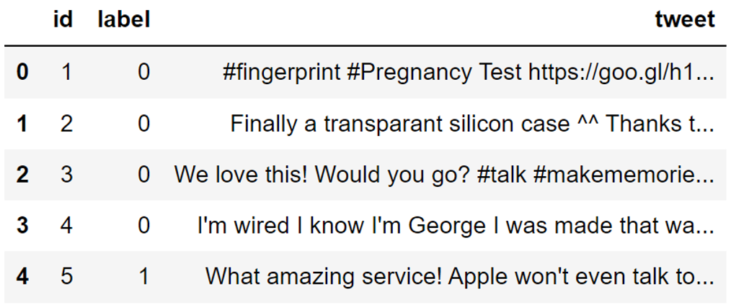
Initial Dataset
There are 7920 different tweets in the dataset.
03

Slide 4





Preprocess the Dataset
Convert uppercase to lowercase
Remove links
Remove punctuation marks
Remove numbers
Remove stopwords
Lemmatization
04

Slide 5
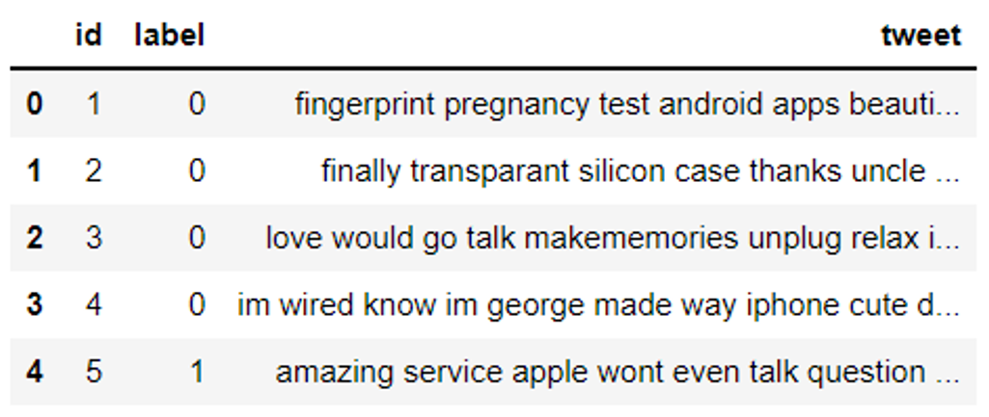
After Preprocessing
There are 7920 different tweets in the dataset.
05

Slide 6

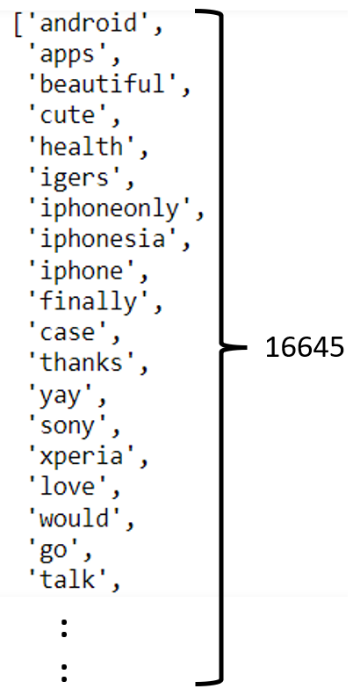


Building a Vocabulary
I love Python programming language
Python is a popular programming language
Vocabulary =
[ I, love, Python, programming, language, is, a popular ]
06

Slide 7
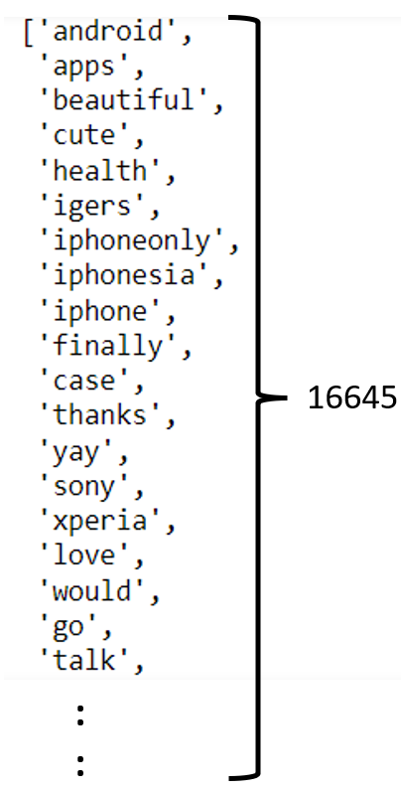
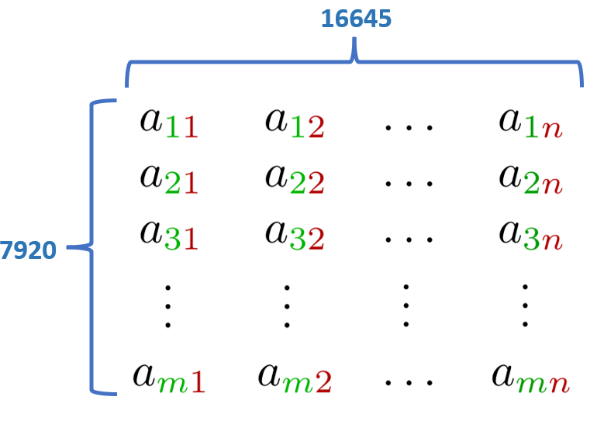
07

Slide 8
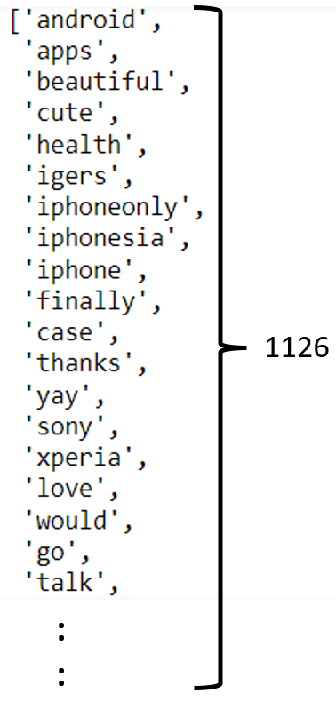
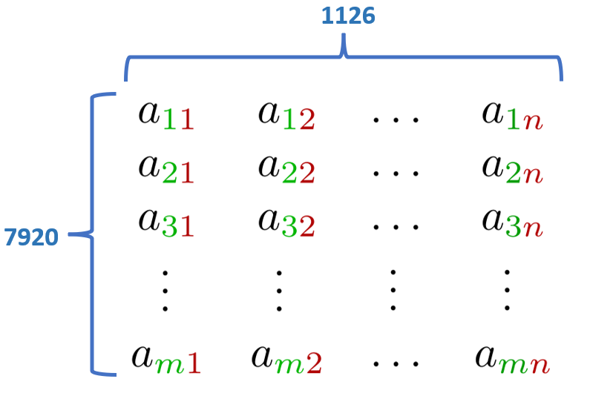
08

Slide 9
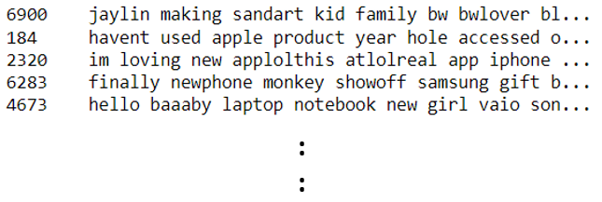
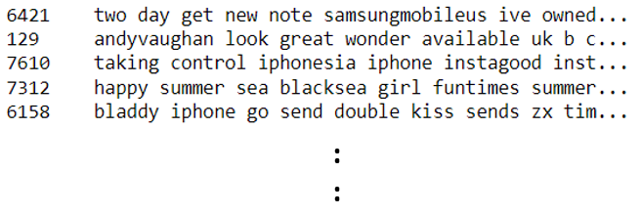
Divide Dataset
Dataset
( 7920 Tweets )
Training Set
Testing Set
( 6336 Tweets )
(1584 Tweets )
09

Slide 10


Handle imbalanced Dataset (Oversampling)
Positive
25%
SMOTE
Technique
Positive
50%
Negative
50%
Negative
75%
10

Slide 11
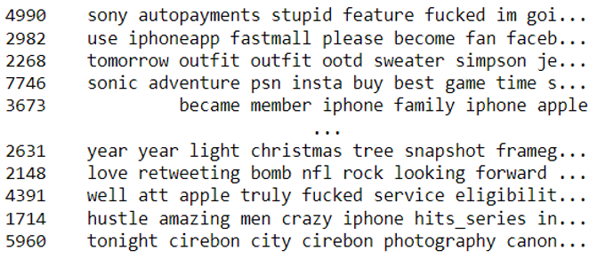
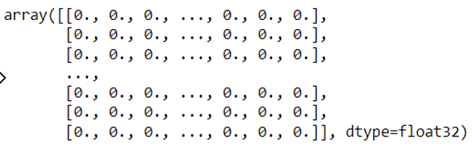
Vectorization
Python is a general-purpose programming language
[ I, love, Python, programming, language, is, a, popular ]
[ 0, 0 , 1 , 1 , 1 , 1 , 1 , 0 ]
11

Slide 12

Modeling
Logistic Regression
Naïve Bayes
Random Forest
Gradient Boosting
Support Vector Machine
12

Slide 13





Model Evaluation
ML Algorithm | Accuracy | Precision | Recall | F1 Score
Logistic Regression | 0.87 | 0.87 | 0.87 | 0.77
Naive Bayes | 0.86 | 0.86 | 0.86 | 0.77
Random Forest | 0.87 | 0.87 | 0.87 | 0.74
Gradient Boosting | 0.88 | 0.88 | 0.88 | 0.77
Support Vector Machine | 0.88 | 0.88 | 0.88 | 0.78
13

Slide 14

Thank You
14

